Slide 1

P peline
The Data
Introductory Statistics: Correlation & Causality
© Jennifer Mankoff & Nikola Banovic
The Data Pipeline; HCII; Spring 2017

Slide 2
Causality
Explain the concept of causation
How do we infer causality?
How do we prove it?
Why is it hard to prove causality
Why do we need to prove causality?
But first! Correlation.

Slide 3

Leibovici, L. (2001). Effects of remote, retroactive intercessory prayer on outcomes in patients with bloodstream infection: Randomised controlled trial. Bmj, 323(7327), 1450-1451.
Notes:
HAND OUT ARTICLE, READ and discuss.
Can you envision a study that would convince you that a cause can lead to something happening in the past?

Slide 4
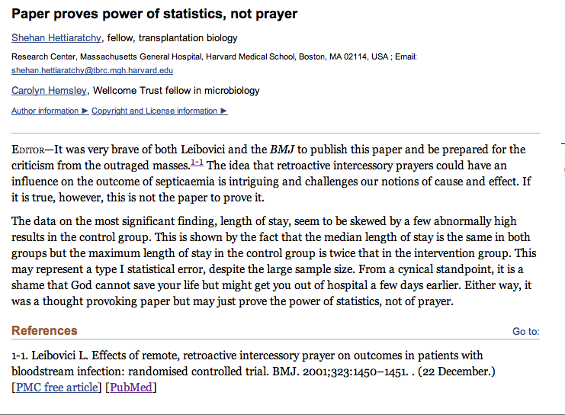
Adapted from class by Samantha Kleinberg

Slide 5
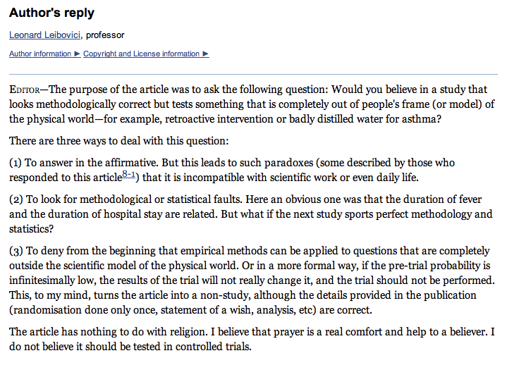
Leibovici’s reply
Adapted from class by Samantha Kleinberg
Notes:
http://www.ncbi.nlm.nih.gov/pmc/articles/PMC1122963/

Slide 6
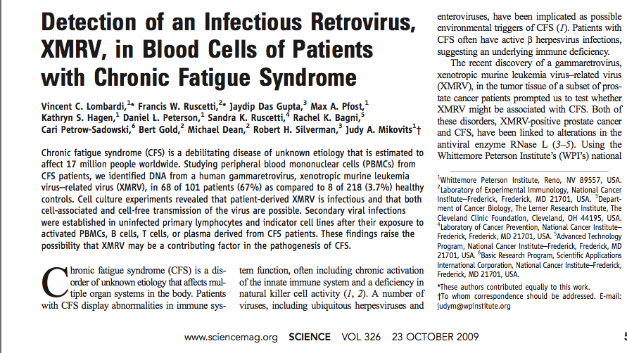
XMRV leads to CFS?
Adapted from class by Samantha Kleinberg

Slide 7

XMRV leads to CFS?
“I think it settles the issue of whether the initial report was real or not”
Adapted from class by Samantha Kleinberg

Slide 8
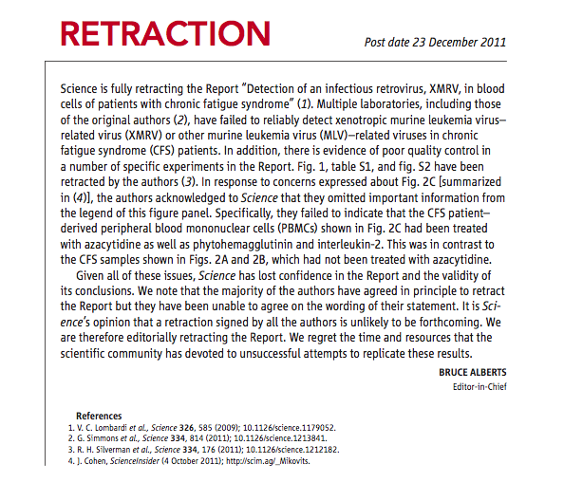
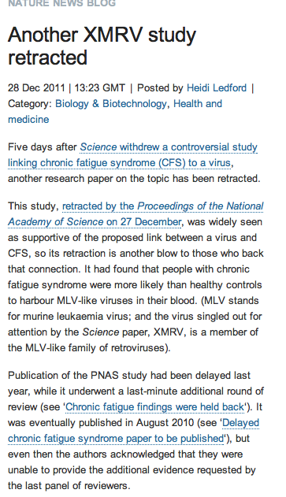
But …
Adapted from class by Samantha Kleinberg
Notes:
http://www.nature.com/news/the-scientist-who-put-the-nail-in-xmrv-s-coffin-1.11444
March 2011
Scientists at NIH present research showing that XMRV emerged from two different mouse viruses in the laboratory during the 1990s. The implication, one author told Nature, is that this virus, born in a laboratory, has probably been infecting laboratory samples for more than a decade, but not people. Meanwhile, a Nature profile of Judy Mikovits highlights growing tensions between Mikovits and her former collaborators on the initial report.

Slide 9
Dependence/independence
Events that are independent
Flipping heads and then tails
Day of week and whether a patient had a heart attack (probably?)
Events that are dependent
Vice presidential candidate and presidential nominee
Diagnostic test being positive and whether patient has a disease
Adapted from class by Samantha Kleinberg

Slide 10

Regularities and experience
Past experience leads to expectation
Hear noise
Go to window
to verify
Prediction was false
Only with empirical evidence, can we make and test predictions
Adapted from class by Samantha Kleinberg

Slide 11
Correlation
Comparing Variables Systematically

Slide 12
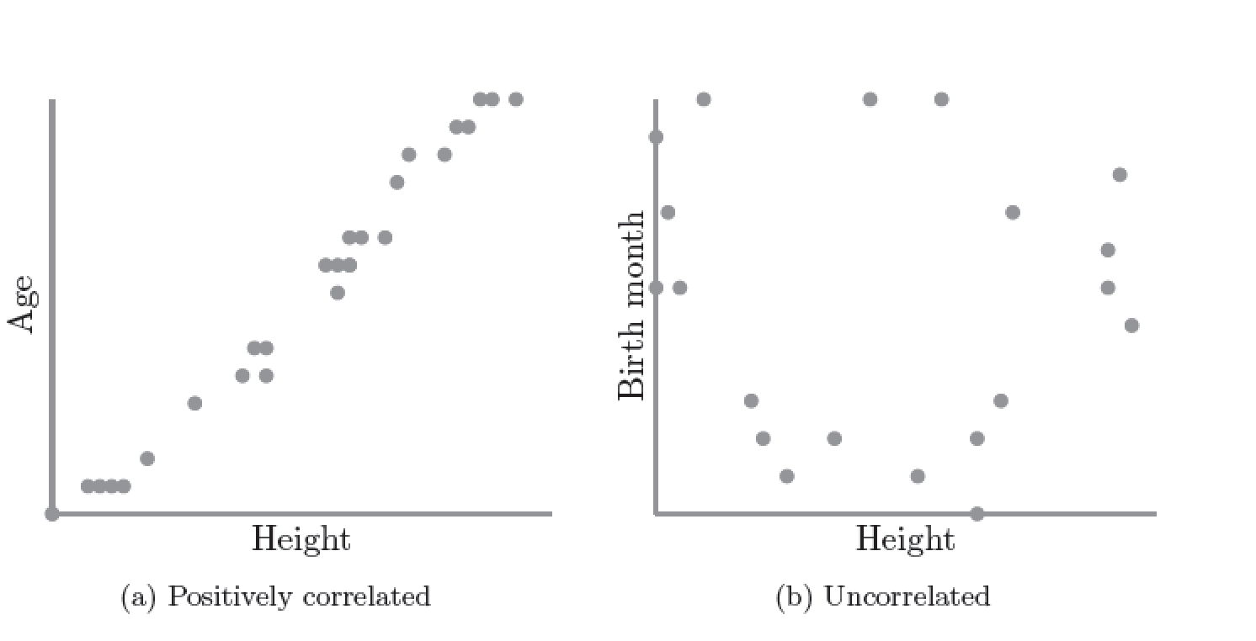
Correlation
S. Kleinberg (2015) Why: A Guide to Finding and Using Causes. O’Reilly Media.

Slide 13
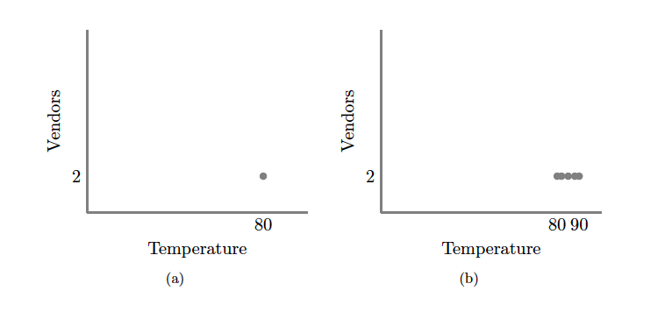
S. Kleinberg (2015) Why: A Guide to Finding and Using Causes. O’Reilly Media.
Notes:
No correlation without variation. Note: this is what happens if you ask only winners why they won

Slide 14
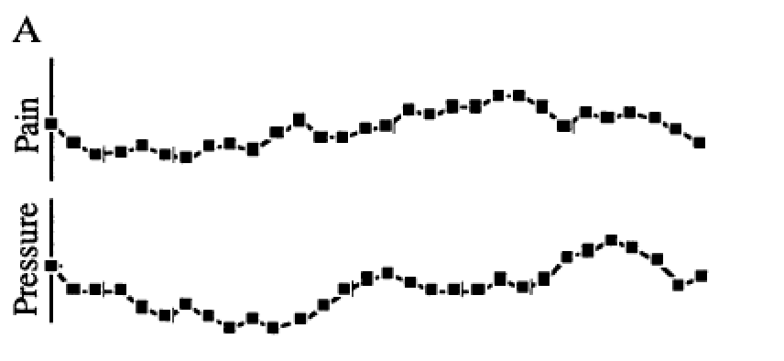
Redelmeier DA, Tversky A (1996) On the belief that arthritis pain is related to the weather. Proceedings of the National Academy of Sciences 93(7):2895-2896.
Notes:
XX look up original ref for this
Fig. 1A were judged as positively related by 87%, as negatively related by 2%, and as unrelated by 11% of participants.
It is correlated

Slide 15
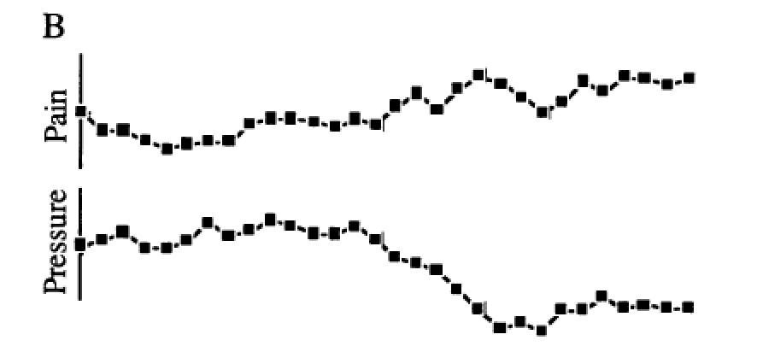
Redelmeier DA, Tversky A (1996) On the belief that arthritis pain is related to the weather. Proceedings of the National Academy of Sciences 93(7):2895-2896.
Notes:
The two uncorrelated sequences in Fig. 1B were judged as positively related by 3%, as negatively related by 79%, and as unrelated by 18% of participants.

Slide 16
Correlation = 0!
Redelmeier DA, Tversky A (1996) On the belief that arthritis pain is related to the weather. Proceedings of the National Academy of Sciences 93(7):2895-2896.
Notes:
XX test students
Cognitive bias
Fig. 1A were judged as positively related by 87%, as negatively related by 2%, and as unrelated by 11% of participants. The two uncorrelated sequences in Fig. 1B were judged as positively related by 3%, as negatively related by 79%, and as unrelated by 18% of participants.

Slide 17
Scatter Plots and Correlation
A correlation analysis measures of association (relationship) between two variables
These variables change together
Usually scale (interval or ratio) variables
Analysis techniques limited to linear relationships

Slide 18
What is “Linear”?
Remember this:
Y=mX+B?
m (slope)
B (intercept)
Adapted from: http://www.sjsu.edu/people/steven.macramalla/courses/stats95/s1/lecture 10
Notes:
A slope of 2 means that every 1-unit change in X yields a 2-unit change in Y.

Slide 19
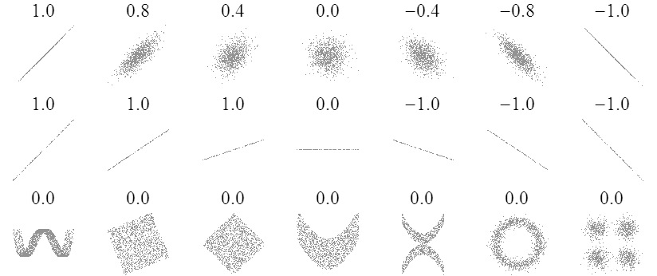
Sample Correlations
Adapted from: http://www.sjsu.edu/people/steven.macramalla/courses/stats95/s1/lecture 10
19

Slide 20
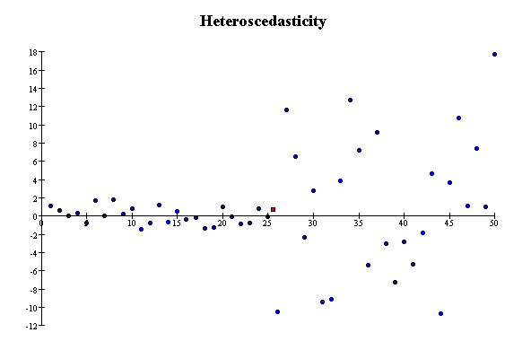
Correlation Assumptions
Key Assumptions:
X values are normally distributed within the population (for each Y)
Y values are normally distributed within the population (for each X)
X and Y have a linear relationship
There are no significant outliers
Scatter doesn’t vary over X or Y

Slide 21
Residual Analysis for Linearity
y
y
x
x
residuals
x
x
residuals
✓
Not Linear
Linear
Slide from: Statistics for Managers Using Microsoft® Excel 4th Edition, 2004 Prentice-Hall

Slide 22
Residual Analysis for Constant Variance (Homoscedasticity)
y
y
x
x
residuals
x
x
residuals
✓
Non-constant variance
Constant variance
Slide from: Statistics for Managers Using Microsoft® Excel 4th Edition, 2004 Prentice-Hall

Slide 23
Residual Analysis for Independence
✓
Not Independent
Independent
residuals
X
residuals
X
residuals
X
Slide from: Statistics for Managers Using Microsoft® Excel 4th Edition, 2004 Prentice-Hall

Slide 24
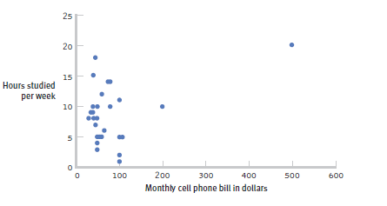
The effect of outliers
One outlier changed the correlation from -0.14 to 0.39!
Adapted from: http://www.sjsu.edu/people/steven.macramalla/courses/stats95/s1/lecture 10
Notes:
Note negative to positive change among other things
----- Meeting Notes (2/19/15 10:00) -----
cook's distance

Slide 25
Pearson Correlation Coefficient
(continued)
The population correlation coefficient ρ (rho) measures the strength of the association between the variables
The sample correlation coefficient r is an estimate of ρ and is used to measure the strength of the linear relationship in the sample observations
Adapted from http://www.fordham.edu/economics/Vinod/correl-regr.ppt

Slide 26
Features of ρ and r
Unit free
Range between -1 and 1
The closer to 0, the weaker the linear relationship
Adapted from http://www.fordham.edu/economics/Vinod/correl-regr.ppt

Slide 27
Calculating the Pearson Correlation Coefficient
Sample correlation coefficient:
or the algebraic equivalent:
where:
r = Sample correlation coefficient
n = Sample size
x = Value of the independent variable
y = Value of the dependent variable
Adapted from http://www.fordham.edu/economics/Vinod/correl-regr.ppt

Slide 28
Measuring correlation
Cups of coffee (X) vs. correct test answers (Y)
X | Y
0 | 1
1 | 1
3 | 3
4 | 5
5 | 5
Notes:
Mean of X 2.6, mean of y 3
Coffee is as related to correct answers as vice versa

Slide 29
Correlation is not Causation
There is a 0.91 correlation between ice cream consumption and drowning deaths.
Does eating ice cream cause drowning?
Does grief cause us to eat more ice cream?
Adapted from: http://www.sjsu.edu/people/steven.macramalla/courses/stats95/s1/lecture 10

Slide 30
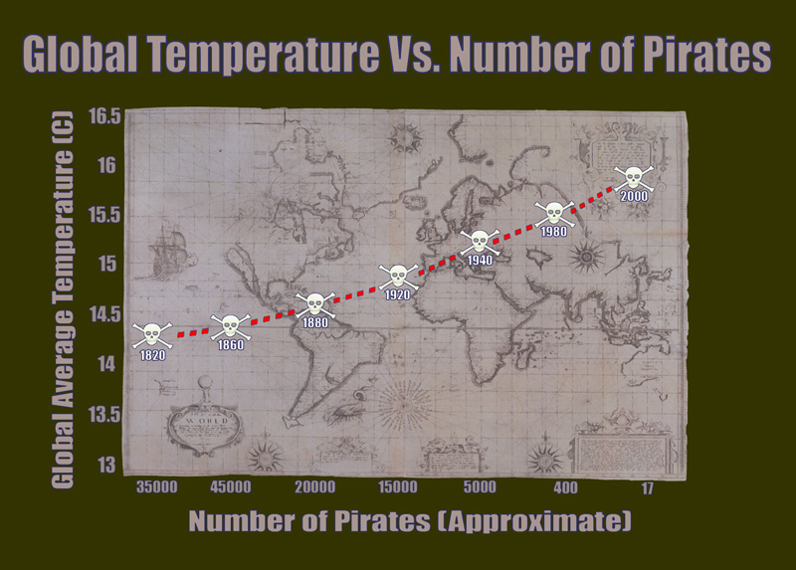
Correlation without causation (1)
http://bama.ua.edu/~sprentic
Notes:
http://bama.ua.edu/~sprentic/101%20Psych%20&%20Life--Correlation-causation.htm
But why shouldn’t we use pirates to predict temperature?
Now, why do we think pirates don’t cause global warming, or global warming doesn’t cause piracy?

Slide 31
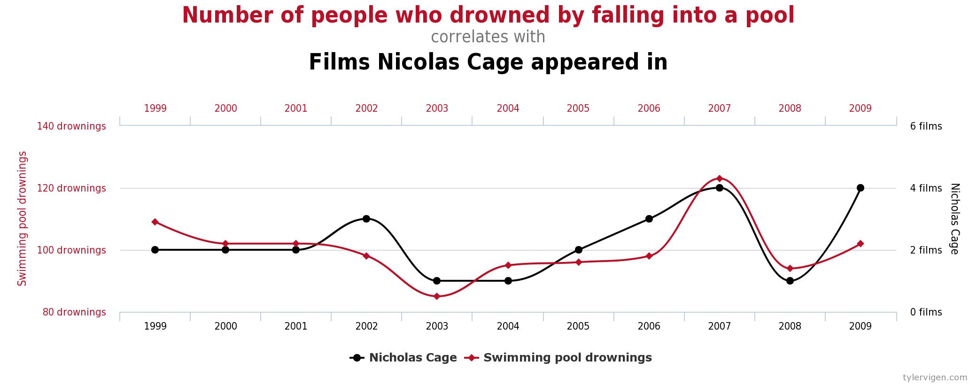
Correlation without causation (1)

Slide 32

Correlation != Causality
Adapted from http://www.fordham.edu/economics/Vinod/correl-regr.ppt

Slide 33


Correlation with some causation
Notes:
Directionality = why we can’t use it for prediction!
Umbrella vendors out before rain
Observe out of order

Slide 34
Correlation Summary
Measures association (linear relationship) between two variables
These variables change together
Usually scale (interval or ratio) variables
Limited in its applicability to normal, linearly related data with consistent scatter and no outliers
Often mistaken for causation
Notes:
changes in a few data-analysis decisions can increase the false-positive rate in a single study to 60%.

Slide 35
What is causation?
Discuss with your neighbor.
Notes:
changes in a few data-analysis decisions can increase the false-positive rate in a single study to 60%.

Slide 36
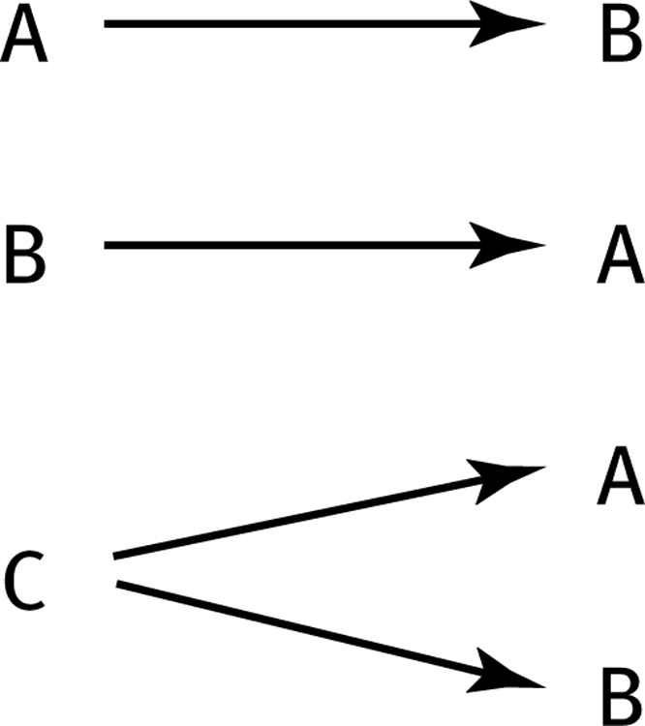
How can we test these associations?
Three Possible Causal Explanations for a Correlation
Adapted from: http://www.sjsu.edu/people/steven.macramalla/courses/stats95/s1/lecture 10

Slide 37
How can we test these associations?
Three Possible Causal Explanations for a Correlation
Adapted from: http://www.sjsu.edu/people/steven.macramalla/courses/stats95/s1/lecture 10
Notes:
Special case for C: C = Time (shared change over time)

Slide 38
Correlation Summary
Measures association (linear relationship) between two variables
These variables change together
Usually scale (interval or ratio) variables
Limited in its applicability to normal, linearly related data with consistent scatter and no outliers
Often mistaken for causation
Cannot easily determine if there is a mediating variable
Notes:
changes in a few data-analysis decisions can increase the false-positive rate in a single study to 60%.

Slide 39
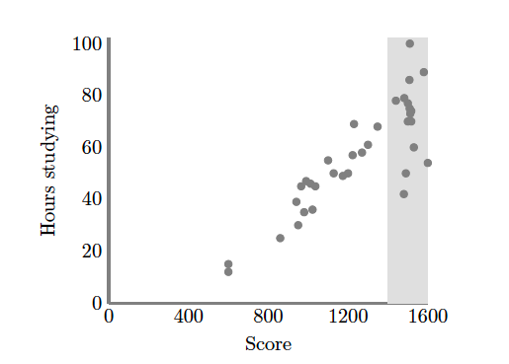
Causation without correlation
S. Kleinberg (2015) Why: A Guide to Finding and Using Causes. O’Reilly Media.
Notes:
Restricted range. Only observing grey area
Illustrate restricted range on board. When else does that happen? Surveying political website users

Slide 40
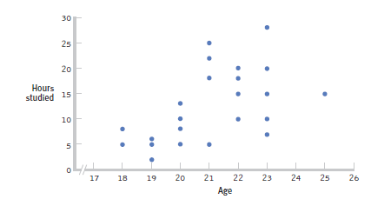
Restricted Range: Sampling Bias
Boys and girls who performed in the top 2% to 3% on standardized
Adapted from: http://www.sjsu.edu/people/steven.macramalla/courses/stats95/s1/lecture 10
Notes:
tests - a much smaller range than the full population from which the researchers could have drawn their sample.

Slide 41
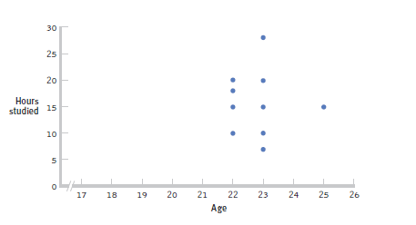
Further Restrictions
Only students between the ages of 22 and 25: r= 0.05.
Adapted from: http://www.sjsu.edu/people/steven.macramalla/courses/stats95/s1/lecture 10

Slide 42
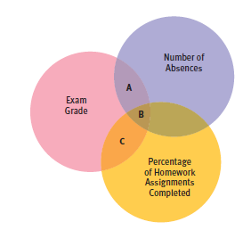
Partial Correlation
Quantifies the degree of association between two variables after statistically removing the association of a third variable with both of those two variables.
e.g., number of absences and exam grade, over and above the correlation of percentage of completed homework assignments with these variables.
Adapted from: http://www.sjsu.edu/people/steven.macramalla/courses/stats95/s1/lecture 10

Slide 43
Simpson’s Paradox
http://en.wikipedia.org/wiki/Simpson's_paradox
Introducing another variable may change our understanding of the data
It may even reverse the initial conclusions

Slide 44
A situation where the subgroups are always the way to go
 | Treatment A | Treatment B
Small Stones | Group 1 93% (81/87) | Group 2 87% (234/270)
Large Stones | Group 3 73% (192/263) | Group 4 69% (55/80)
Both | 78% (273/350) | 83% (289/350)
Notes:
Which data should we consult in choosing an action, the aggregated or the partitioned?
Kidney Stone example above, it is clear that if one is diagnosed with "Small Stones" or "Large Stones" the data for the respective subpopulation should be consulted and Treatment A would be preferred to Treatment B.
what if a patient is not diagnosed, and the size of the stone is not known; would it be appropriate to consult the aggregated data and administer Treatment B? This would stand contrary to common sense; a treatment that is preferred both under one condition and under its negation should also be preferred when the condition is unknown.

Slide 45
Gender Discrimination?
 | Applicants | Admitted
Men | 8442 | 44%
Women | 4321 | 35%
Notes:
On the other hand, if the partitioned data is to be preferred a priori, what prevents one from partitioning the data into arbitrary sub-categories (say based on eye color or post-treatment pain) artificially constructed to yield wrong choices of treatments?
Pearl[2] shows that, indeed, in many cases it is the aggregated, not the partitioned data that gives the correct choice of action.
Worse yet, given the same table, one should sometimes follow the partitioned and sometimes the aggregated data, depending on the story behind the data; with each story dictating its own choice. Pearl[2] considers this to be the real paradox behind Simpson's reversal.

Slide 46
Gender Discrimination?
Dept | Men | Women
A | 825/62% | 108/82%
B | 560/63% | 25/68%
C | 325/37% | 593/34%
D | 417/33% | 375/35%
E | 191/28% | 393/24%
F | 373/6% | 341/7%
Bickel et al.[13]: women tended to apply to competitive departments with low rates of admission (English), men tended to apply to less-competitive departments with high rates of admission engineering and chemistry)

Slide 47
Correlation Summary
Measures association (linear relationship) between two variables
These variables change together
Usually scale (interval or ratio) variables
Limited in its applicability to normal, linearly related data with consistent scatter and no outliers
Often mistaken for causation
Cannot easily determine if there is a mediating variable
Range restriction & other manipulations can affect or even reverse outcomes (Simpson’s paradox)
Notes:
changes in a few data-analysis decisions can increase the false-positive rate in a single study to 60%.

Slide 48
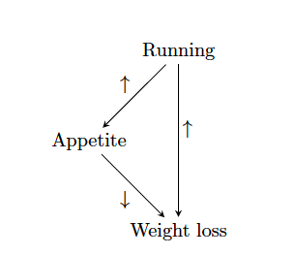
Strangely…
Causation also does not imply correlation
S. Kleinberg (2015) Why: A Guide to Finding and Using Causes. O’Reilly Media.

Slide 49
Causation without correlation
Treatment
 | Dead | Alive
A | 85 | 215 (72%)
B | 59 | 241 (80%)
Total | 144 | 456
Notes:
Treatment B is standard, A is experimental approach
Who wants treatment A and who wants treatment B?

Slide 50
Causation without correlation (2)
Treatment | Men |  | Women |  | Combined
 | Dead | Alive | Dead | Alive | Dead | Alive
A | 80 | 120 (60%) | 5 | 95 (95%) | 85 | 215 (72%)
B | 20 | 20 (50%) | 39 | 221 (85%) | 59 | 241 (80%)
Total | 100 | 140 | 44 | 316 | 144 | 456
Baker SG, Kramer BS (2001) Good for women, good for men, bad for people: Simpson's paradox and the importance of sex-specific analysis in observational studies. Journal of women's health & gender-based medicine 10: 867-872
Notes:
http://www.ncbi.nlm.nih.gov/pubmed/11747681
Ask: so what actually happened?
Levels of granularity matter!!!
Men have higher mortality rate, and more of them got treatment A than B, biasing the sample and vice versa with women.

Slide 51
Frequentist vs Bayesian Approaches
Formalizing Causality

Slide 52
Common Statistical Tests: T-Test
T-Test
Tests for difference between two samples
Best used to determine what is ‘worthy of a second look’
Limited in its applicability to normal, independent data
The more implausible the hypothesis, the greater chance that it is a ‘false alarm’
Does not help to document effect size [the actual difference between groups], just effect likelihood
Susceptible to ‘data dredging’
Varied tests looking for a significant result
Adjustments mid experiment
Notes:
changes in a few data-analysis decisions can increase the false-positive rate in a single study to 60%.

Slide 53
Two samples
p
x

Slide 54
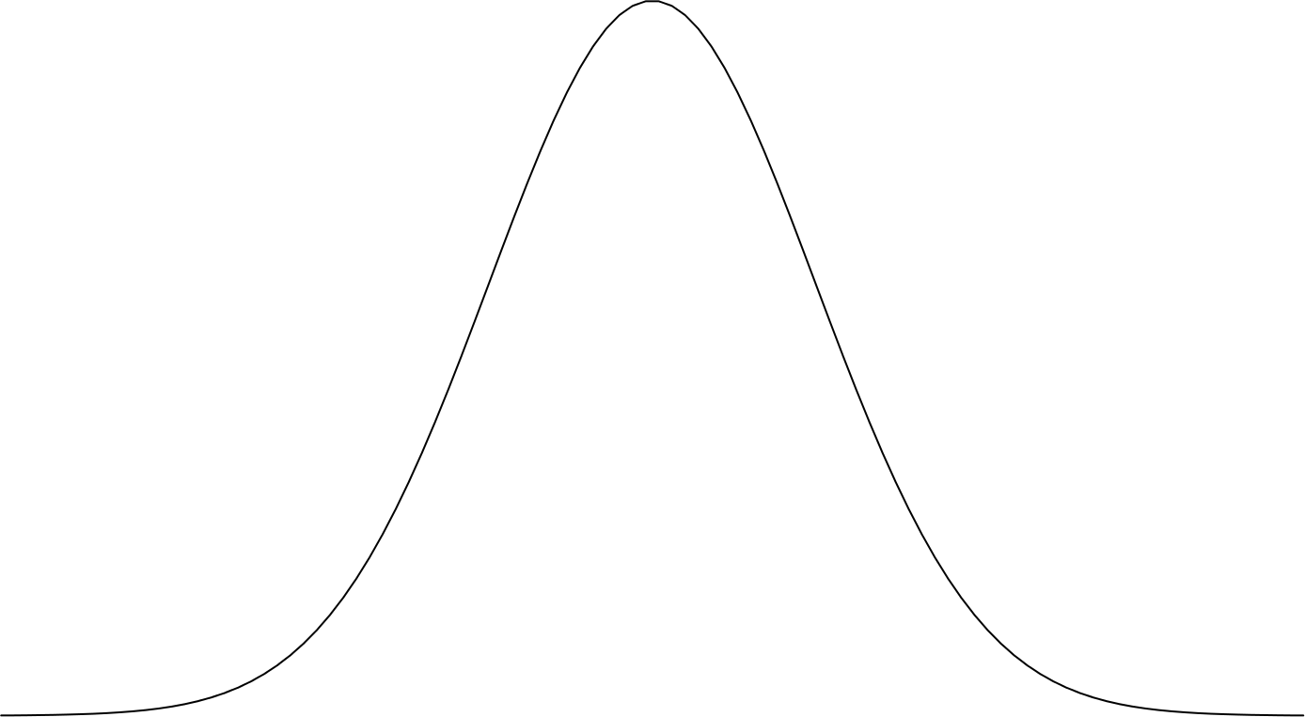
Where is the mean?
p
x

Slide 55
Where is the mean?
p
x

Slide 56
Where is the mean?
p
x

Slide 57
Where is the mean?
m₁
m₂
p
x

Slide 58
Is there a difference?
m₁
m₂
p
x

Slide 59
95% confidence interval
95% confidence interval
m₁
m₂
p
x

Slide 60
Is there a difference?
m₁
m₂
p
x

Slide 61
95% confidence interval
95% confidence interval
m₁
m₂
p
x

Slide 62
m₁
m₂
p
x

Slide 63
m₁
m₂
p
x

Slide 64
m₁
m₂
p
x

Slide 65
m₁
m₂
p
x

Slide 66
95% confidence interval
95% confidence interval
m₁
m₂
p
x

Slide 67
95% confidence interval
95% confidence interval
m₁
m₂
p
x

Slide 68
95% confidence interval
95% confidence interval
m₁
m₂
p
Effect size
x

Slide 69
m₁
m₂
p
x

Slide 70
m₁
m₂
p
x

Slide 71
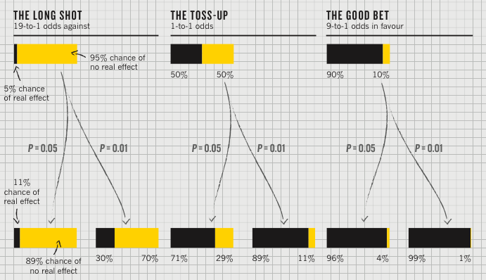
Importance of priors
P value
Best used to determine what is ‘worthy of a second look’ [Nuzzo]
Limited in its applicability

Slide 72
Plausibility of the hypothesis (inference)
P value
Best used to determine what is ‘worthy of a second look’ [Nuzzo]
Limited in its applicability
‘Prior’: Before the
experiment

Slide 73
‘Statistical significance’
P value
Best used to determine what is ‘worthy of a second look’ [Nuzzo]
Limited in its applicability
Calculated p value
Notes:
Does not incorporate the inference (the top of this chart) directly

Slide 74
Actual implications of the p-value
P value
Best used to determine what is ‘worthy of a second look’ [Nuzzo]
Limited in its applicability
Hypothesis more plausible than it should be (Type I Error)
Notes:
Does not incorporate the inference (the top of this chart) directly

Slide 75
Actual implications of the p-value
P value
Best used to determine what is ‘worthy of a second look’ [Nuzzo]
Limited in its applicability
Alternatively, a small sample may cause a Type II error (failure to detect a true difference) due to random sampling bias
Notes:
Does not incorporate the inference (the top of this chart) directly

Slide 76
What does this have to do with causality?
Example: A/B testing
What to know if A better or B better
E.g., A is stylus, B is finger
Measure speed of entering text
Split participants in two groups.
Hold everything the same, except…
Group 1 uses stylus (A); group 2 uses finger (B)
Run a null hypothesis test
Then if there is a difference in typing speed, we can say it was caused by text entry method (A/B)

Slide 77
95% confidence interval
95% confidence interval
m₁
m₂
p
Effect size
Finger
Stylus
Text entry method

Slide 78
m₂
m₁
Mean speed
Finger
Stylus
Text entry method

Slide 79
Flaws with p values
Does not tell us the likelihood something is true. It only lets us reject or accept a hyp.
Gives a yes or no answer: Either the null hypothesis is rejected (the result would be unlikely [defined by α] in a world where the null hypothesis was true) or it cannot be rejected
Doesn’t take prior knowledge into account
Based on assumed ‘average’ sample

Slide 80
Further flaws
These are estimates and we can make two kinds of errors (false positives & negatives)
These statistics depend on the central limit theorem and thus its assumptions
The sample is normal
If multiple samples, they are independent & have the same variance
Can only reject hypotheses [as discussed]
Notes:
Note: Add a little more about the last point

Slide 81
Potential Errors
 | Actually is: Same as Population | Actually is: Different than Population
Decision: is Same | H₀ (null): No difference | False negative
Decision: is Different | False positive | H₁: Real difference

Slide 82
Could our Estimate Be Wrong?
 | Actually is: Same as Population | Actually is: Different than Population
Decision: is Same | H₀ (null): No difference | False negative
Decision: is Different | False positive | H₁: Real difference
Erroneously detect a difference (Type I error). Directly affected by α: at .05 we make a Type I error 5 out of 100 tries. .01 reduces this error to 1 out of 100 tries.

Slide 83
Could our Estimate Be Wrong?
 | Actually is: Same as Population | Actually is: Different than Population
Decision: is Same | H₀ (null): No difference | False negative
Decision: is Different | False positive | H₁: Real difference
Fail to detect a true difference (Type II error) Indirectly affected by α: Depends on the size of the mean difference and the sample size.

Slide 84
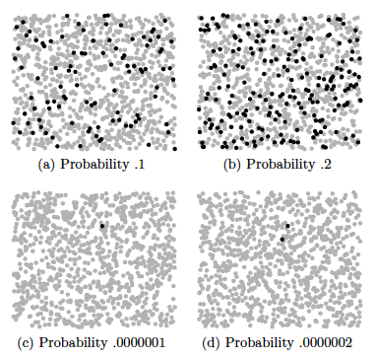
Type II errors (failure to detect difference) also caused by small effect size
S. Kleinberg (2015) Why: A Guide to Finding and Using Causes. O’Reilly Media.
Notes:
Each dot represents 10,000 events, except in the lower two figures, where black
dots are single events.
Is this a problem?

Slide 85
False positive and negative Error Tradeoffs
Suppose there is a test for a particular disease (H₀ is that the person is disease free)
If the person is sick and is diagnosed early, she can be successfully treated
If it is not diagnosed and treated, the person will become severely disabled
If a person is erroneously diagnosed as having the disease and treated, no physical damage is done.
To which type of error you are willing to risk ?

Slide 86
Could our Estimate Be Wrong?
 | No Disease | Disease
Not Diagnosed | OK | False negative
Diagnosed | False positive | Ok

Slide 87
Could our Estimate Be Wrong?
 | No Disease | Disease
Not Diagnosed | OK | False negative
Diagnosed | False positive | Ok
Not treated; irreparable damage is done
Treated, but not harmed by treatment
Decision: to reduce the chance of false negatives (Type II errors), increase α (e.g. from .01 to .05)

Slide 88
Testing of hypotheses False positives & negatives
The probability of making a Type II error (β) can be decreased by increasing the level of significance (α).
it will increase the chance of false positives (Type I errors)

Slide 89
Testing of hypotheses False positives & negatives: Example
Suppose there is a test for a particular disease (H₀ is that the person is disease free)
If the person is sick and is diagnosed early, she can be successfully treated
If it is not diagnosed and treated, the person will eventually heal, but may lose some work days
If a person is erroneously diagnosed as having the disease and treated, serious damage may be done.
To which type of error you are willing to risk ?

Slide 90
Could our Estimate Be Wrong?
 | No Disease | Disease
Not Diagnosed | OK | False negative
Diagnosed | False positive | Ok
Minor loss of work days
Treated, harmed by treatment
Decision: to reduce the chance of false positives (Type I errors), decrease α (e.g. from .05 to .01)

Slide 91
Testing of hypotheses False positives & negatives
there is only 5 chance in 100 that the result termed "significant" could occur by chance alone
α =0.05
The probability of making a Type I error can be decreased by further reducing α
it will be more difficult to find a significant result
the power of the test will be decreased
the risk of false negatives will be increased

Slide 92
Types of errors
Potential Pitfalls typically leading to Type I errors
Low rate of replication of findings [Ionnadis]
Bias (‘findings’ may actually be measuring bias) [Ionnadis]
Lack of careful data exploration (charts & summarization) [Hart]
Potential Pitfalls leading to Type II Errors
Low power (probability of rejecting a false hypothesis i.e. Type II errors) in studies [Colquhuon]
Notes:
Note: Add a little more about the last point
Start with process data and analysis, only then explore frequency data and analysis
Interpreting results must be done with respect to real world expectations about the population

Slide 93
Beyond Binary Hypothesis Testing
What was role of cause in effect’s occurrence?
Anne drives drunk and crashes car. What’s significance of her drinking for the crash?
Could be
Because of
Despite
Independently of

Slide 94
Four relations
Despite
y is Y despite x if the probability of Y is lowered after x_{t’}
Because
y is Y because of x if the probability of Y is increased after x_{t’} and remains increased until y_{t}
Autonomously
y is Y autonomously of x if the probability of Y changes at x_{t’}, this probability is high, but then decreases before y_{t}
Independently
y is Y independently of x if the probability of Y is the same just after x_{t’} as it is just before x_{t’}

Slide 95
Caveats
How can we know all the important factors?
How can we find the probability trajectory?

Slide 96
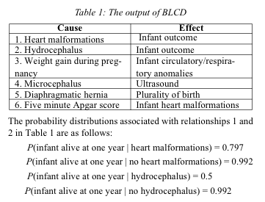
Example: infant mortality
n binary variables = 2^n entries
Mani, S., & Cooper, G. F. (2004). Causal Discovery Using a Bayesian Local Causal Discovery Algorithm. Proceedings of MedInfo, 731-735

Slide 97
Graphical model
Describes independencies in a set of variables

Slide 98
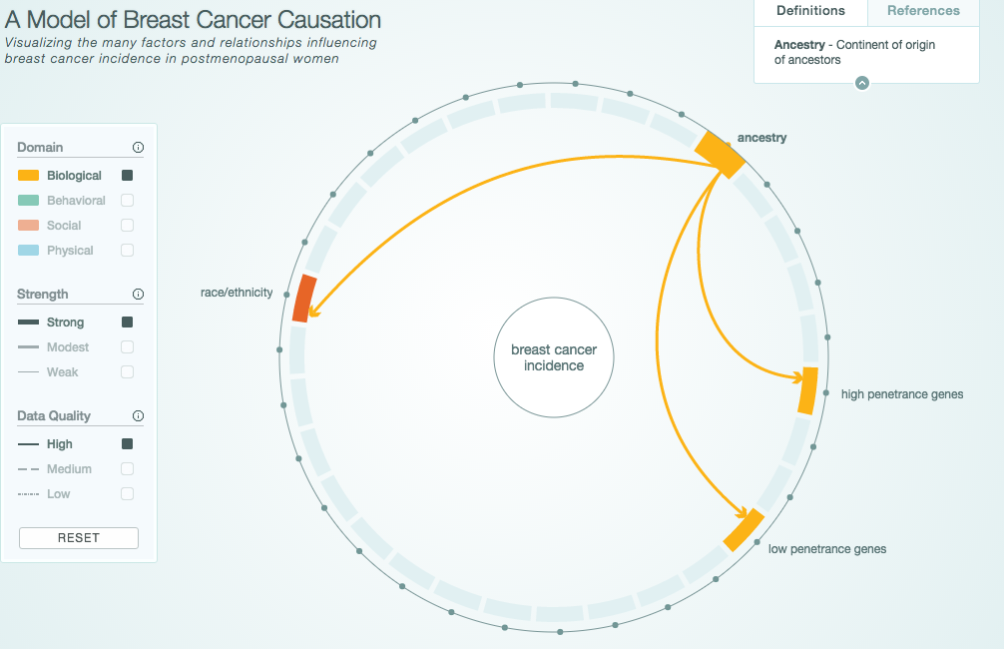
Graphical Model Example
http://www.cabreastcancer.org/causes/#

Slide 99
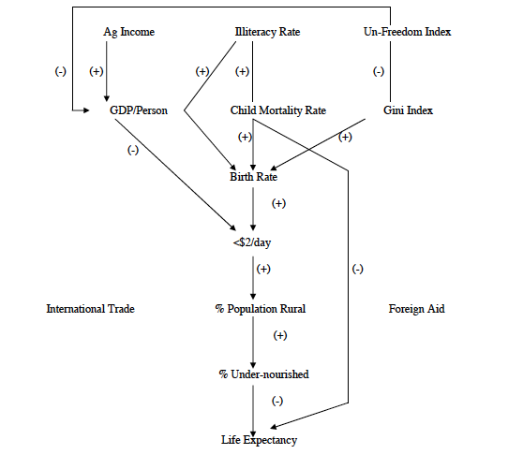
Application: Causes and effects of poverty
Bessler, D. A. (2003). On world poverty: Its causes and effects. Food and Agricultural Organization (FAO) of the United Nations, Research Bulletin, Rome

Slide 100
Graphical models and explanation
Graphical model that represents relationships between variables
Observations give truth value of variables in particular scenario
Use model to evaluate counterfactual queries

Slide 101
Example things to beware of
Sample size
Missing data (not just variables)
What structures DAG can/cannot represent (e.g. time series and feedback)

Slide 102
Summary
A cause implies that one event is dependent on one or more other events in some way (at least some of the time)

Slide 103
Summary
A cause implies interdependence
Assuming you have measured the right variables, a scatterplot/correlation can sometimes show that such a relationship exists (but not what the direction of the relationship is)

Slide 104
Summary
A cause implies interdependence
Scatterplots/correlation can highlight the existence of such relationships (but not prove causality)
T-tests typical of ‘frequency’ reasoning, are susceptible to error, and give limited information

Slide 105
Summary
A cause implies interdependence
Scatterplots/correlation can highlight the existence of such relationships (but not prove causality)
T-tests are limited, and based on frequency data
A theory of the world (process data) can improve the quality of your results and give probabilities rather than yes/no results

Slide 106
Assessing Causality

Slide 107
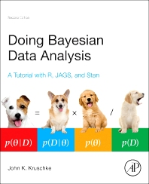
Great book ,wrong language

Slide 108
Basic steps
Identify the data relevant to the question
Measurement scales
Variables to be predicted
Predictors
Example: weight given height
Notes:
Sound familiar?

Slide 109
Basic steps
Identify the data relevant to the question
Define a descriptive model for the relevant data
graphical model
appropriate theoretical underpinnings
Example: ŷ = β₁x+β₀ and y ~ normal(ŷ, σ)
Where ŷ = predicted weight and x = height and y = actual weights. y values near ŷ may be considered most probable
Can fit this using regression
Notes:
Makes sense to me… requires you to really think about your problom

Slide 110
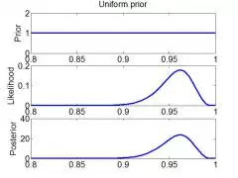
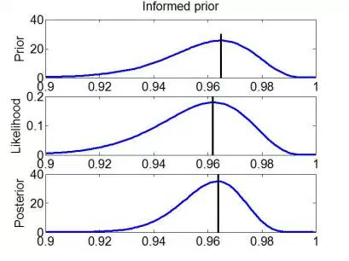
Basic steps
Identify the data relevant to the question
Define a descriptive model for the relevant data
Specify a prior distribution
Notes:
Requires research!

Slide 111
Basic steps
Identify the data relevant to the question
Define a descriptive model for the relevant data
Specify a prior distribution
Estimate the posterior distribution
Re-allocate credibility across parameter values (using Bayesian inference: solve for θ)
P(θ|D) = p(D|θ) p(θ) / p(D)
Where p(D) = ∫dθ*p(D|θ*)p(θ*)
In our example: θ includes β₁β₀ and σ
posterior likelihood prior evidence
Notes:
θ^{* is distinct from} θ – it represents all values the parameters can take on rather than a single value. -- average likelihood, or evidence. A sum for discrete θ, an integral otherwise.

Slide 112
Priors

Slide 113
Creating the posterior distribution
Estimate distribution of values for parameters consistent with the data
In our example, β₁, β₀ and σ
Most credible value for slope is maximum of distribution (4.1)
Can calculate the ‘high density interval’ (HDI) (95% of the distribution)
Notes:
Requires research!

Slide 114
Basic steps
Identify the data relevant to the question
Define a descriptive model for the relevant data
Specify a prior distribution
Estimate the posterior distribution
Check the model (randomly generate simulated y values at selected x values many many times)

Slide 115
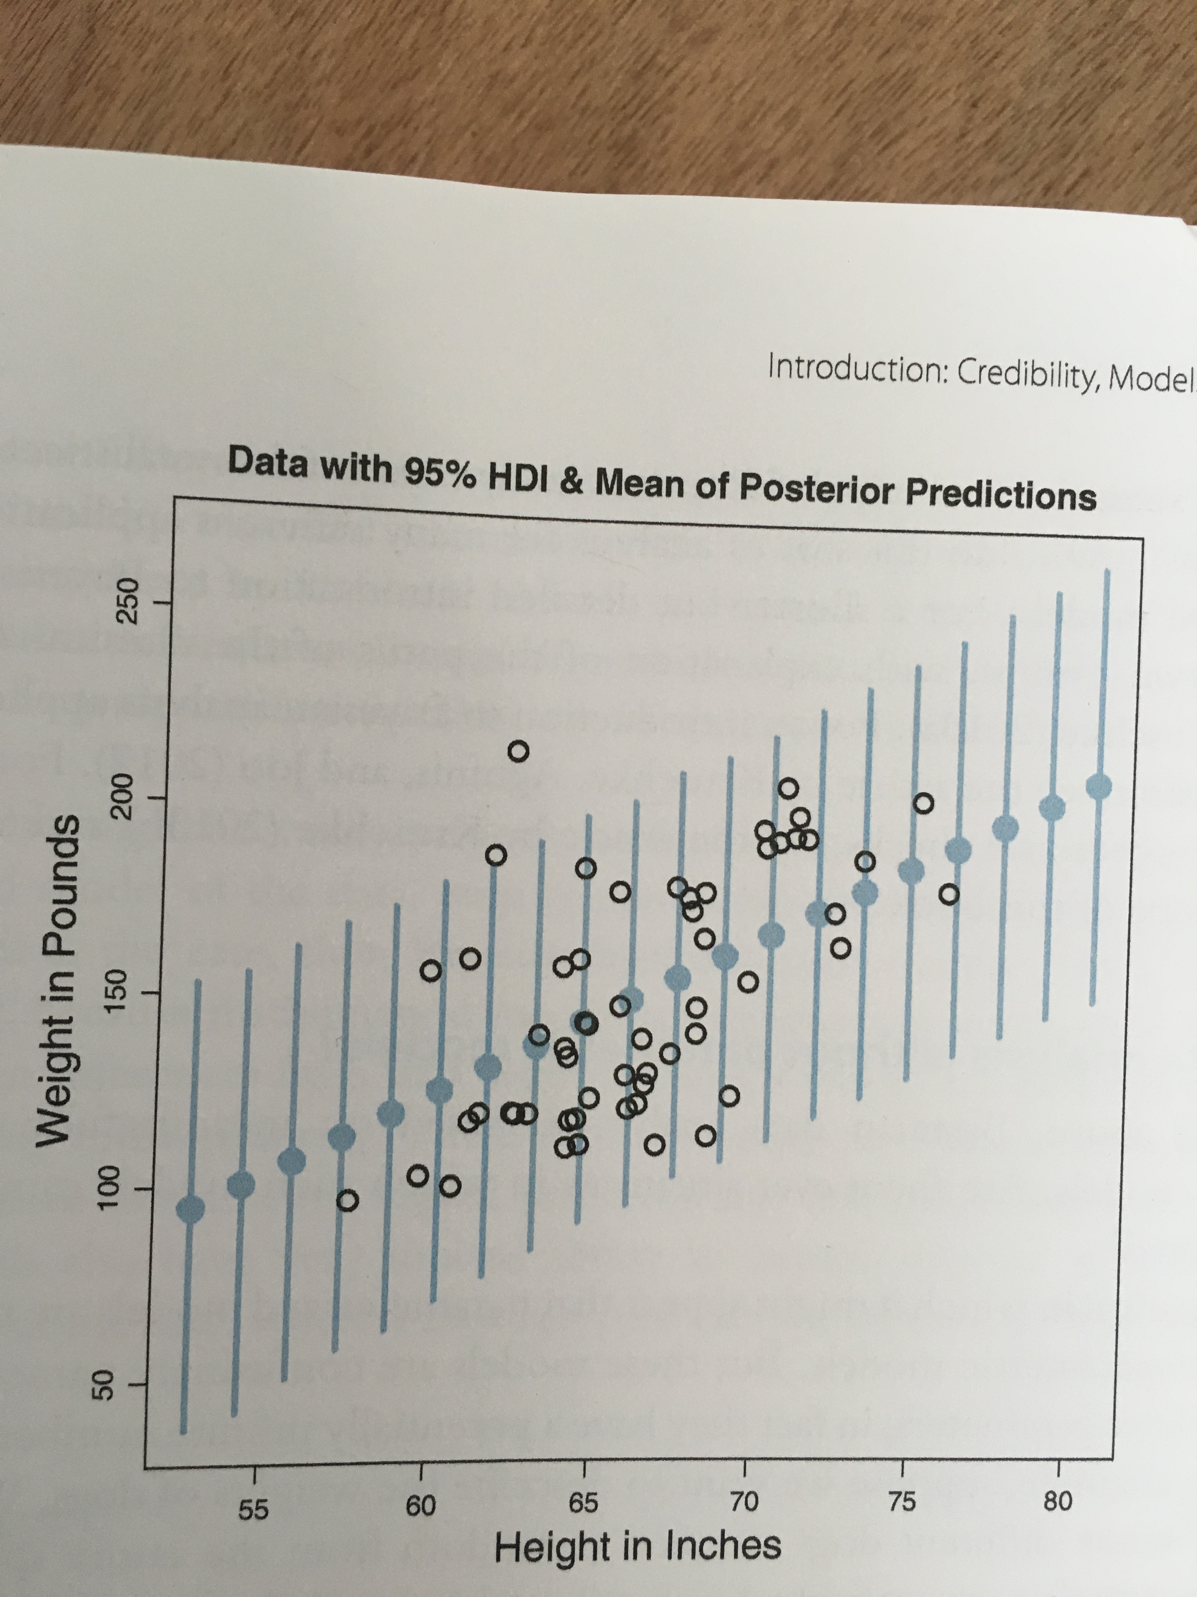
Basic steps
Identify the data relevant to the question
Define a descriptive model for the relevant data
Specify a prior distribution
Estimate the posterior distribution
Check the model (randomly generate simulated y values at selected x values many many times)
Notes:
Simulation … helps us to asses credibility. Dot shows the mean of the predicted values.

Slide 116
Reconsidering what we know about disease
Test Result | Disease |  | Marginal (test result)
T= + 99% hit rate ½ % false pos
T = -
Marginal(disease) | P(sick) = .001 | P(healthy) = 1 - .001 | 1
Notes:
Base rate of disease: .001
Test ‘hit rate’ is 99%
False alarm rate: ½ %

Slide 117
Reconsidering what we know about disease
Test Result | Disease |  | Marginal (test result)
T= + 99% hit rate ½ % false pos | P(+|sick)p(sick) = 0.99 * 0.001 | P(+|healthy)(p(healthy) = .05 * 1 - .001 | = ∑p(+|θ)p(θ)
T = - | P(-|sick)p(sick) = (1 – 0.99) * .001 | P(-|healthy)p(healthy) = (1 - .05) * (1 - .001) | = ∑p(-|θ)p(θ)
Marginal(disease) | P(sick) = .001 | P(healthy) = 1 - .001 | 1
Notes:
Base rate of disease: .001

Slide 118
Reconsidering what we know about disease: The impact of priors
Test Result | Disease |  | Marginal (test result)
T= + 99% hit rate ½ % false pos | P(+|sick)p(sick) = 0.99 * 0.001 | P(+|healthy)(p(healthy) = .05 * 1 - .001 | = ∑p(+|θ)p(θ)
T = - | P(-|sick)p(sick) = (1 – 0.99) * .001 | P(-|healthy)p(healthy) = (1 - .05) * (1 - .001) | = ∑p(-|θ)p(θ)
Marginal(disease) | P(sick) = .001 | P(healthy) = 1 - .001 | 1
P(+|θ=sick) p (θ=sick)
.99*.001
P(θ=sick|+) = = = .019
∑p(+|θ)p(θ)
.99*.001 + .05*(1-.001)
Notes:
1.9% !!! This is the importance of priors

Slide 119
Solving for θ
Numerical approximation (sum over many discrete representative values instead of interval)
Randomly sampling a large number of representative combinations of parameter values from the posterior distribution (Markov chain Monte Carlo methods)
Regression

Slide 120
Statistical Regression Analysis
Regression analysis is used to:
Predict the value of a dependent variable based on the value of at least one independent variable
Explain the impact of changes in an independent variable on the dependent variable
Dependent variable: the variable we wish to explain
Independent variable: the variable used to do so
Adapted from http://www.fordham.edu/economics/Vinod/correl-regr.ppt

Slide 121
Relationship with correlation
In correlation, the two variables are treated as equals.
In regression, one variable is considered independent (=predictor) variable (X) and the other the dependent (=outcome) variable Y.

Slide 122
Regression in Machine Learning
Regression analysis is used to:
Predict the value of a continues variable based on the value of one or more features
Dependent variable: the outcome we wish to predict
Features: summaries of information about things we measured that should predict the outcome

Slide 123
Simple Linear Regression Model
Only one independent variable, x
Relationship between x and y is described by a linear function
Changes in y are assumed to be caused by changes in x
Adapted from http://www.fordham.edu/economics/Vinod/correl-regr.ppt

Slide 124
Population Linear Regression
The population regression model:
Population Slope Coefficient
Random Error term, or residual
Population y intercept
Independent Variable
Dependent Variable
Linear component
Random Error
component
Adapted from http://www.fordham.edu/economics/Vinod/correl-regr.ppt

Slide 125
Population Linear Regression
y
Observed Value of y for x_{i}
Random Error for x_{i}
ε_{i}
Slope = β₁
Predicted Value of y for x_{i}
Regression Line
Intercept = β₀
x_{i}
x
Adapted from http://www.fordham.edu/economics/Vinod/correl-regr.ppt

Slide 126
Estimated Regression Model
y
Estimated Intercept = b₀
Estimated Regression Line
Estimated Slope = b₁
x
Notes:
Is this any good? How do you know?

Slide 127
Better Estimate
y
Random Error for x_{i}
e_{i}
b₁
b₀
x
x
Notes:
Better?

Slide 128
Estimated Regression Model
y
Observed y for x_{i}
Random Error for x_{i}
e_{i}
b₁
Predicted for x_{i}
b₀
x
x_{i}
x
The individual random error terms e_{i} have a mean of zero
Notes:
We need to solve for y by estimating b0 and b1
b₀ is the estimated average value of y when the value of x is zero
b₁ is the estimated change in the average value of y as a result of a one-unit change in x
The simple regression line always passes through the mean of the y variable and the mean of the x variable

Slide 129
Least Squares Criterion
b₀ and b₁ must minimize
y
e_{i}
Estimated Slope = b₁
Intercept = b₀
x

Slide 130
Least Squares Criterion
b₀ and b₁ must minimize
y
Observed Value of y for x_{i}
e_{i}
Estimated Slope = b₁
Predicted Value for x_{i}
Intercept = b₀
x
Notes:
Note we can replace y-cap with b0 – b1x

Slide 131
Least Squares Criterion
b₀ and b₁ must minimize
Adapted from http://www.fordham.edu/economics/Vinod/correl-regr.ppt
Notes:
Note we can replace y-cap with b0 – b1x

Slide 132
Least Squares Regression Properties
The sum of the residuals from the least squares regression line is 0.
The sum of the squared residuals is a minimum.
The simple regression line always passes through the mean of the y variable and the mean of the x variable.
The least squares coefficients are unbiased estimates of β₀ and β₁.
Adapted from www.clt.astate.edu/asyamil/groebner/ppts/PP11final.ppt

Slide 133
Linear Regression Assumptions
Error values (ε) are statistically independent
Error values are normally distributed for any given value of x
The probability distribution of the errors is normal
The probability distribution of the errors has constant variance
The underlying relationship between the x variable and the y variable is linear
Adapted from www.clt.astate.edu/asyamil/groebner/ppts/PP11final.ppt
Notes:
In machine learning we can play with these a bit – will get to this next week

Slide 134
Simple Linear Regression Example
A real estate agent wishes to examine the relationship between the selling price of a home and its size (measured in square feet)
A random sample of 10 houses is selected
Dependent variable (y) = house price in $1000s
Independent variable (x) = square feet
Adapted from http://www.fordham.edu/economics/Vinod/correl-regr.ppt

Slide 135
Sample Data for House Price Model
House Price in $1000s (y) | Square Feet (x)
245 | 1400
312 | 1600
279 | 1700
308 | 1875
199 | 1100
219 | 1550
405 | 2350
324 | 2450
319 | 1425
255 | 1700
Adapted from http://www.fordham.edu/economics/Vinod/correl-regr.ppt

Slide 136
Graphical Presentation
House price model: scatter plot and regression line
Slope
= 0.10977
Intercept
= 98.248
Adapted from http://www.fordham.edu/economics/Vinod/correl-regr.ppt
Notes:
Here, no houses had 0 square feet, so b₀ = 98.24833 just indicates that, for houses within the range of sizes observed, $98,248.33 is the portion of the house price not explained by square feet

Slide 137
Graphical Presentation
House price model: scatter plot and regression line
Slope
= 0.10977
Intercept
= 98.248
Adapted from http://www.fordham.edu/economics/Vinod/correl-regr.ppt

Slide 138
Graphical Presentation
House price model: scatter plot and regression line
Slope
= 0.10977
Intercept
= 98.248
Adapted from http://www.fordham.edu/economics/Vinod/correl-regr.ppt
Notes:
Here, b₁ = .10977 tells us that the average value of a house increases by .10977($1000) = $109.77, on average, for each additional one square foot of size

Slide 139
Example: House Prices
Estimated Regression Equation:
House Price in $1000s (y) | Square Feet (x)
245 | 1400
312 | 1600
279 | 1700
308 | 1875
199 | 1100
219 | 1550
405 | 2350
324 | 2450
319 | 1425
255 | 1700
Predict the price for a house with 2000 square feet
Adapted from http://www.fordham.edu/economics/Vinod/correl-regr.ppt

Slide 140
Example: House Prices
Estimated Regression Equation:
House Price in $1000s (y) | Square Feet (x)
245 | 1400
312 | 1600
279 | 1700
308 | 1875
199 | 1100
219 | 1550
405 | 2350
324 | 2450
319 | 1425
255 | 1700
Predict the price for a house with 2000 square feet
Adapted from http://www.fordham.edu/economics/Vinod/correl-regr.ppt

Slide 141
Example: House Prices
Estimated Regression Equation:
House Price in $1000s (y) | Square Feet (x)
245 | 1400
312 | 1600
279 | 1700
308 | 1875
199 | 1100
219 | 1550
405 | 2350
324 | 2450
319 | 1425
255 | 1700
Predict the price for a house with 2000 square feet
The predicted price for a house with 2000 square feet is 317.85($1,000s) = $317,850
Adapted from http://www.fordham.edu/economics/Vinod/correl-regr.ppt

Slide 142
Coefficient of Determination
after minimizing

Slide 143
Explained and Unexplained Variation
(continued)
y
y_{i}
∧
∧
SSE = ∑(y_{i} - y_{i} )²
y
_
SST = ∑(y_{i} - y)²
∧
y
_
∧
_
SSR = ∑(y_{i} - y)²
_
y
y
x
X_{i}

Slide 144
Explained and Unexplained Variation
SSE = Error sum of squares. Variation attributable to factors other than the relationship between x and y
(continued)
y
y_{i}
∧
∧
SSE = ∑(y_{i} - y_{i} )²
y
_
SST = ∑(y_{i} - y)²
∧
y
_
∧
_
SSR = ∑(y_{i} - y)²
_
y
y
x
X_{i}

Slide 145
Unexplained error in House Price Model (SSE)
Unexplained variation makes R² .581
Intercept
= 98.248
Notes:
Here, b₁ = .10977 tells us that the average value of a house increases by .10977($1000) = $109.77, on average, for each additional one square foot of size

Slide 146
Explained and Unexplained Variation
SSE = Error sum of squares. Used to calculate Standard Error of regression
(continued)
y
y_{i}
∧
∧
SSE = ∑(y_{i} - y_{i} )²
y
_
SST = ∑(y_{i} - y)²
∧
y
_
∧
_
SSR = ∑(y_{i} - y)²
_
y
y
x
X_{i}

Slide 147
Standard Error of Estimate
The standard deviation of the variation of observations around the regression line is estimated by
Where
SSE = Sum of squares error
n = Sample size
k = number of independent variables in the model
Adapted from http://www.fordham.edu/economics/Vinod/correl-regr.ppt

Slide 148
Explained and Unexplained Variation
SST = Total sum of squares. Used for R². Measures the variation of the y_{i} values around their mean y
(continued)
y
y_{i}
∧
∧
SSE = ∑(y_{i} - y_{i} )²
y
_
SST = ∑(y_{i} - y)²
∧
y
_
∧
_
SSR = ∑(y_{i} - y)²
_
y
y
SSR = Regression sum of squares. Used for R². Explained variation attributable to the relationship between x and y
x
X_{i}

Slide 149
Simple Linear Regression Analysis
COEFFICIENT OF DETERMINATION (R²)
(sum of squares regression)
(total sum of squares)
Notes:
The coefficient of determination is the portion of the total variation in the dependent variable that is explained by its relationship with the independent variable. The coefficient of determination is also called R-squared and is denoted as R2.

Slide 150
Simple Linear Regression Analysis
COEFFICIENT OF DETERMINATION (R²)
House Price in $1000s (y) | Square Feet (x) | Predicted House Price (ŷ)
245 | 1400 | 251.97
312 | 1600 | 273.93
279 | 1700 | 284.91
308 | 1875 | 304.125
199 | 1100 | 219.03
219 | 1550 | 268.44
405 | 2350 | 356.28
324 | 2450 | 367.26
319 | 1425 | 254.715
255 | 1700 | 284.91
Notes:
The coefficient of determination is the portion of the total variation in the dependent variable that is explained by its relationship with the independent variable. The coefficient of determination is also called R-squared and is denoted as R2.

Slide 151
Simple Linear Regression Analysis
COEFFICIENT OF DETERMINATION (R²)
House Price in $1000s (y) | Square Feet (x) | Predicted House Price (ŷ)
245 | 1400 | 251.97
312 | 1600 | 273.93
279 | 1700 | 284.91
308 | 1875 | 304.125
199 | 1100 | 219.03
219 | 1550 | 268.44
405 | 2350 | 356.28
324 | 2450 | 367.26
319 | 1425 | 254.715
255 | 1700 | 284.91
Predicted y
Notes:
The coefficient of determination is the portion of the total variation in the dependent variable that is explained by its relationship with the independent variable. The coefficient of determination is also called R-squared and is denoted as R2.

Slide 152
Simple Linear Regression Analysis
COEFFICIENT OF DETERMINATION (R²)
House Price in $1000s (y) | Square Feet (x) | Predicted House Price (ŷ)
245 | 1400 | 251.97
312 | 1600 | 273.93
279 | 1700 | 284.91
308 | 1875 | 304.125
199 | 1100 | 219.03
219 | 1550 | 268.44
405 | 2350 | 356.28
324 | 2450 | 367.26
319 | 1425 | 254.715
255 | 1700 | 284.91
Mean y
Notes:
The coefficient of determination is the portion of the total variation in the dependent variable that is explained by its relationship with the independent variable. The coefficient of determination is also called R-squared and is denoted as R2.

Slide 153
Simple Linear Regression Analysis
COEFFICIENT OF DETERMINATION (R²)
House Price in $1000s (y) | Square Feet (x) | Predicted House Price (ŷ)
245 | 1400 | 251.97
312 | 1600 | 273.93
279 | 1700 | 284.91
308 | 1875 | 304.125
199 | 1100 | 219.03
219 | 1550 | 268.44
405 | 2350 | 356.28
324 | 2450 | 367.26
319 | 1425 | 254.715
255 | 1700 | 284.91
Mean y = 286.5
Notes:
The coefficient of determination is the portion of the total variation in the dependent variable that is explained by its relationship with the independent variable. The coefficient of determination is also called R-squared and is denoted as R2.

Slide 154
Simple Linear Regression Analysis
COEFFICIENT OF DETERMINATION (R²)
House Price in $1000s (y) | Square Feet (x) | Predicted House Price (ŷ)
245 | 1400 | 251.97
312 | 1600 | 273.93
279 | 1700 | 284.91
308 | 1875 | 304.125
199 | 1100 | 219.03
219 | 1550 | 268.44
405 | 2350 | 356.28
324 | 2450 | 367.26
319 | 1425 | 254.715
255 | 1700 | 284.91
Notes:
The coefficient of determination is the portion of the total variation in the dependent variable that is explained by its relationship with the independent variable. The coefficient of determination is also called R-squared and is denoted as R2.

Slide 155
Simple Linear Regression Analysis
COEFFICIENT OF DETERMINATION (R²)
House Price in $1000s (y) | Square Feet (x) | Predicted House Price (ŷ)
245 | 1400 | 251.97
312 | 1600 | 273.93
279 | 1700 | 284.91
308 | 1875 | 304.125
199 | 1100 | 219.03
219 | 1550 | 268.44
405 | 2350 | 356.28
324 | 2450 | 367.26
319 | 1425 | 254.715
255 | 1700 | 284.91
Notes:
The coefficient of determination is the portion of the total variation in the dependent variable that is explained by its relationship with the independent variable. The coefficient of determination is also called R-squared and is denoted as R2.

Slide 156
Multiple Linear Regression
More than one predictor…
E(y)= α + β₁*X + β₂ *W + β₃ *Z…
Each regression coefficient is the amount of change in the outcome variable that would be expected per one-unit change of the predictor, if all other variables in the model were held constant.

Slide 157
Multivariate regression pitfalls
Multi-co-linearity
Two x’s that measure the same thing
Tend to ‘cancel out’ and wreck the model

Slide 158
Multivariate regression pitfalls
Multi-co-linearity
Two x’s that measure the same thing
Tend to ‘cancel out’ and wreck the model
Residual confounding
Hard to estimate

Slide 159
Multivariate regression pitfalls
Multi-co-linearity
Two x’s that measure the same thing
Tend to ‘cancel out’ and wreck the model
Residual confounding
Hard to estimate
Overfitting
Too many x’s for the data
Minimum 10 new samples per new x
Makes the model less predictive on new samples
Notes:
----- Meeting Notes (3/22/16 10:15) -----
residual confounding

Slide 160
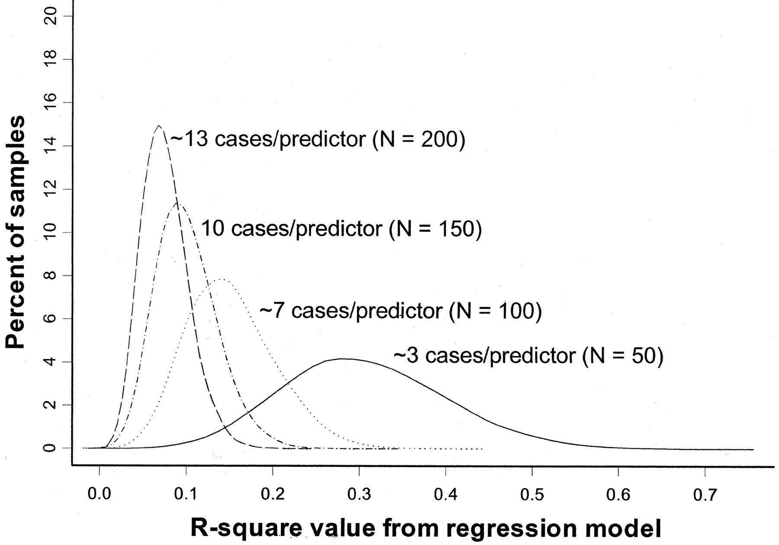
Overfitting simulation (where we know the ‘true’ population has R²=0)
All regression models in simulation have 15 predictors
True R² = 0
(Figure from: Babyak, MA. What You See May Not Be What You Get: A Brief, Nontechnical Introduction to Overfitting in Regression-Type Models. Psychosomatic Medicine 66:411-421 (2004).)
Notes:
The model contained 15 predictors, each consisting of randomly generated values, and a response variable, whose values were also randomly generated

Slide 161
Overfitting: 3 cases/predictor: mean R² looks like .3
R² distribution for 10,000 regressions based on 10,000 random samples of the data (N=50).
(Figure from: Babyak, MA. What You See May Not Be What You Get: A Brief, Nontechnical Introduction to Overfitting in Regression-Type Models. Psychosomatic Medicine 66:411-421 (2004).)
Notes:
Y axis is percent of sample distributions that had a given R2 value (for that N). X axis is distribution of R2 values across the 10,000 regressions (for that N)

Slide 162
Overfitting: 13 cases/predictor: mean R² looks like .05
R² distribution for 10,000 regressions based on 10,000 random samples of the data (N=200)
(Figure from: Babyak, MA. What You See May Not Be What You Get: A Brief, Nontechnical Introduction to Overfitting in Regression-Type Models. Psychosomatic Medicine 66:411-421 (2004).)

Slide 163
Summary
Introduced correlation analysis
Discussed correlation to measure the strength of a linear association
Introduced simple linear regression analysis
Calculated the coefficients for the simple linear regression equation
Addressed assumptions of regression and correlation
Addressed prediction of individual values
Discussed residual analysis
Adapted from http://www.fordham.edu/economics/Vinod/correl-regr.ppt

Slide 164
Summary
Regression tells us to what extent a group of independent variables predict or explain a dependent variable
It is based on the same assumptions as correlation
In addition, predictor variables that are not independent can mess it up
Over fitting can be a problem (too little data for the number of independent variables)

